Slide 1
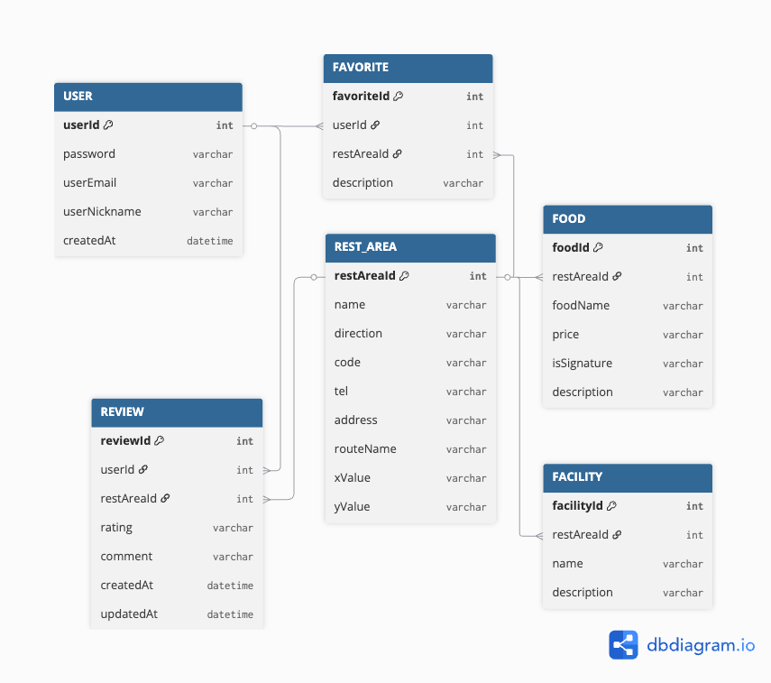
ERD(DataBase Structure)

Slide 2
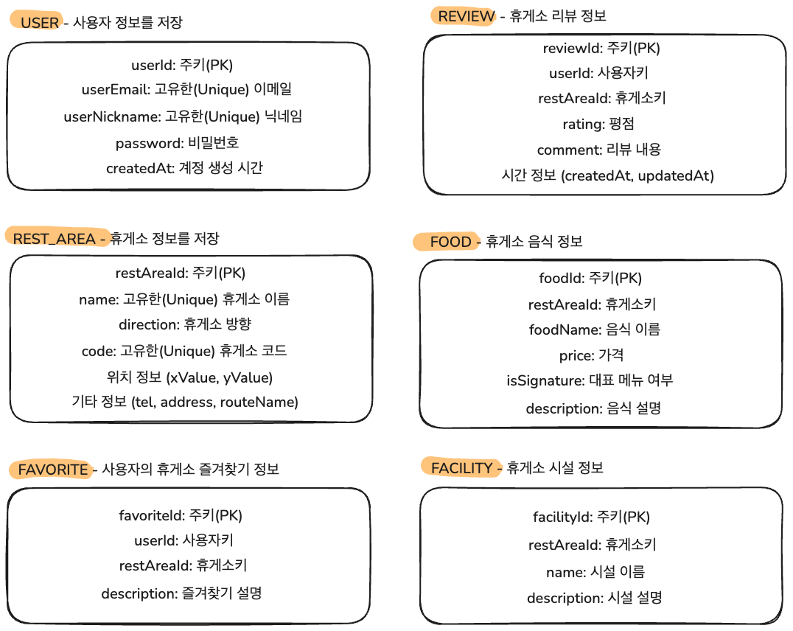
ERD description

